Slide 1
Adoption
Adoption is the legal act of permanently placing a child with a parent or parents other than the birth parents. Adoption results in the severing of the parental responsibilities and rights of the biological parents and the placing of those responsibilities and rights onto the adoptive parents. After the finalization of an adoption, there is generally no legal difference between biological and adopted children, though in some jurisdictions, some exceptions may apply. adoption is cool.
http://en.wikipedia.org/wiki/Adoption

Slide 2
Past Adoption
In the past, adoption consisted of no legal procedures.
Children were to conform to the family they were adopted in to.
People tried to match the child's background to the families background.

Slide 3
1851 adoption of Children Act
Section 1
  Made it legal for a family to adopt children from the commonwealth in which they reside
Section 2
  The process of legal signing away parental rights
Section 3
  Made reference to the fact that if the child is fourteen years of age or older they can disagree with the adoption and it will not be processed
Section 4
  Both the husband and wife must be satisfied of the potential parents abilities to care and raise the child before the processes the adoption

Slide 4
1851 adoption of Children Act cont…
Section 5
  The judge must be satisfied of the potential parents abilities to care and raise the child before he processes the adoption.
Section 6
  States that once the child is adopted, the child is considered the child of the adopters, meaning to act and treat the child as if it were their natural born child, and also to assume all legal responsibilities for the child
Section 7
  Once the birth parents have given the child up for adoption they lose all legal rights to this child.
Section 8
  Any petitioner, or any child that is the subject of the petition, may appeal the adoption without any cost to the appealer.

Slide 5
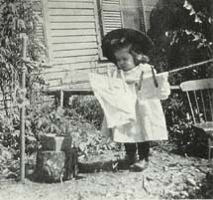
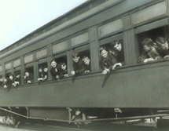
Orphan Trains 1854; “Placing out” movement 1868
Orphan Trains
  The process of placing children without families on trains and sending them to towns to be looked over
  The children will then be chosen by families interested in adopting them
“Placing out” movement
  Placing children in homes rather than institutions such as orphanages
  Paid families to take in children to their homes

Slide 6
Orphan Trains
“From about 1850 through the early twentieth century, thousands of children were transferred from the overcrowded orphanages and homes in the large cities in the northeastern United States, to live with families on farms throughout the middle West. “
“The name orphan train originates with the railroad trains that transported the children to their new homes “
The goal- Provide the children with a better life.
http://www.outfitters.com/~melissa/ot/ot.html

Slide 7
Early 20th Century
1909
  White house conference state that poverty alone is not grounds to remove a child from the home
1910-1930
  The first specialized adoption agencies were founded
  Ran by the women of the elite and whose husbands were very well known in the communities

Slide 8
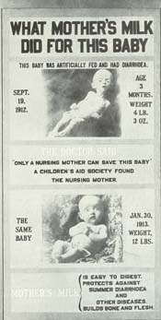
1912 U.S. Children’s Bureau
  Best known for their effort to reduce infant mortality and eradicate child labor
  Handled scandals such as baby farming (common day daycare)
    Mothers were often prostitutes, unwed mothers or destitute and abandoned mothers
    Because of these baby farms we now have minimum standards
      State licensing, certificate of child placers, and investigation of foster homes

Slide 9

Bureau for Exchange of Information Among Child-Helping Organizations 1915
  Later renamed the Child Welfare League of America
    Developed the minimum standards required for both temporary and permanent placements
    Created a constitution that explained standard setting was one of their major purposes
Minnesota Adoption Law 1917
  Law making it mandatory to investigate all adoptions and provide confidentiality of all adoption records
    Information keep secret from
    the public but not from the family
  When adopted new birth certificates are produced and the old ones are sealed away
1948
  First recorded transracial adoption of an African American child by white parents happened
    Took place in Minnesota

Slide 10
Children with special needs
It wasn’t until 1955 that programs were implemented to aid in the adoption of these children
  Children that were typically harder to be placed with families
    Examples
      African American children, Mixed children, children with physical or mental disabilities, older children and sibling groups
  “Adoption is appropriate for any child without family ties who is in need of a family and for whom a family can be found to meet his/her needs.”

Slide 11
Indian Adoption Project
From 1958-1967
  395 Native American children were taken into the hands of the adoption agencies and adopted out
Indian Child Welfare Act 1978
  Most adoption laws were created by the state but in this case it was created by the federal law
  Long history of displacement of Native American Children

Slide 12
1965 single men or women got their chance to adopt a child
  Has always been legal
    Agencies found single parent homes less appealing
1970
  Adoptions reached their century-long statistical peak
    175,000 adoptions per year
    Almost 80% of these adoptions were performed through agencies
  Numbers have dropped
    125,000 adoptions per year

Slide 13
The Adoption Assistance and Child Welfare Act
Implemented in 1980
Program that gave funs to states that supported subsidy programs for special needs adoption and helped families who adopted these children with resources to preserve family unification and prevent abuse, neglect, and child removal

Slide 14
Changes in the 1990s
1994
  Multiethnic Placement Act
    First federal law to prohibit agencies who receive federal funds to deny transracial adoption purely on the basis of race
1996
  Bastard Nation
    Group is made of mostly adult adoptees with two goals
      Open access to records as a matter of basic civil rights
      Free expression of adult adoptees

Slide 15
Child Citizenship Act of 2000
  Foreign-born adoptees were allowed to become full American citizens
    As soon as the children entered the United States they were deemed citizens
  This act eliminated the legal burden of naturalization for international adoptions
  Allowed foreign born adopted children already living in the united states before February 27, 2001 immediate citizens

Slide 16

Adoption Impacts Our View of Ourselves
Adoption forces us to confront questions about:
  Personal identity
  The nature of families
  The relationships between racial and ethnic communities
  The role of different societies’ perspectives on children and families
Notes:
Adoption Impacts Our Changing Families
Fosters improved attitudes
Adoption is advancing ethnic, racial, and cultural diversity, and is contributing to a permanent realignment in the way we think of family structure

Slide 17

Adoption Impacts Our Changing Families
Adoption fosters improved attitudes and behavior throughout society
Adoption is advancing ethnic, racial, and cultural diversity, and is contributing to a permanent realignment in the way we think of family structure

Slide 18
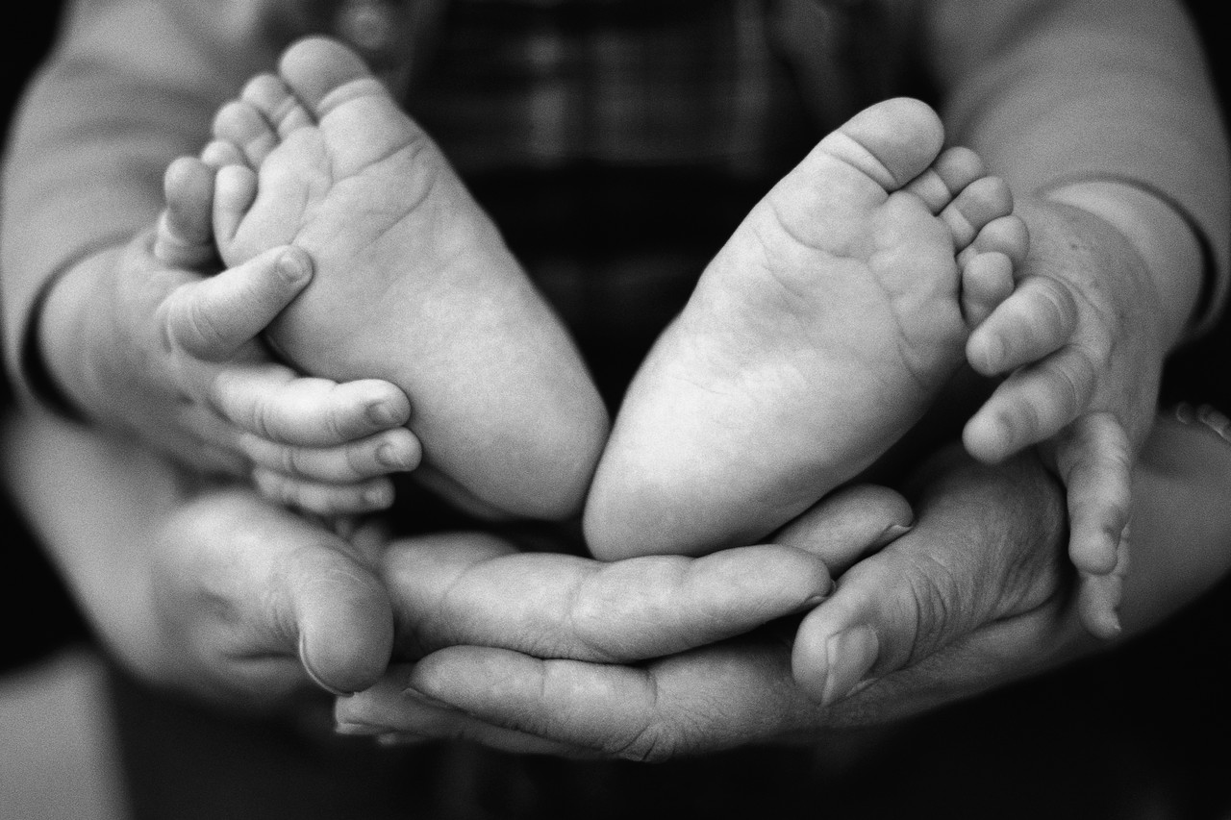

Adoption Impacts a Growing Connection to a Global World
For example: Caucasian parents picking up their African American toddlers at preschool
The media’s exposure about biological and adoptive parents
The celebrities and people down the street proudly announcing the arrival of their adoptive children from China or Guatemala

Slide 19

Adoption Impacts Acceptance of Non-Traditional Families
Acceptance of children with:
  One parent, two divorced parents, two parents of the same gender, a combination of parents and stepparents, children born by way of donated sperm and eggs or surrogate pregnancy, children being raised by grandparents or foster parents, children with siblings from another race

Slide 20
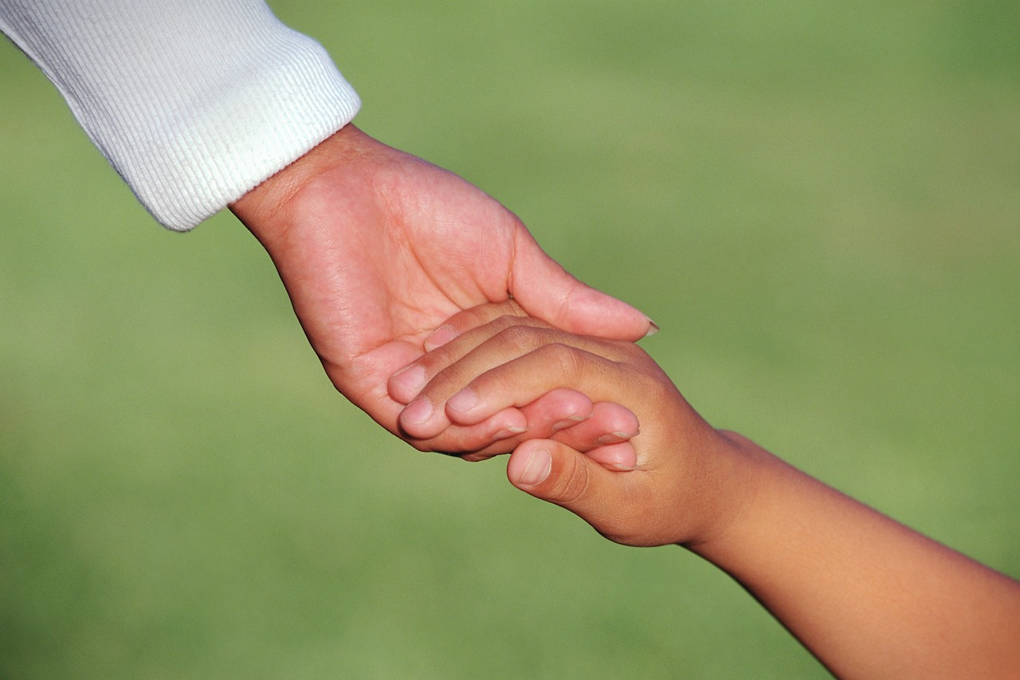
Adoption-Continuing/Future Trends
Married, upper-middle class, white couples continue to adopt non-white children
Family structures continue to be diverse/inter-racial
Advocate programs for adoption among children in foster care in the US

Slide 21
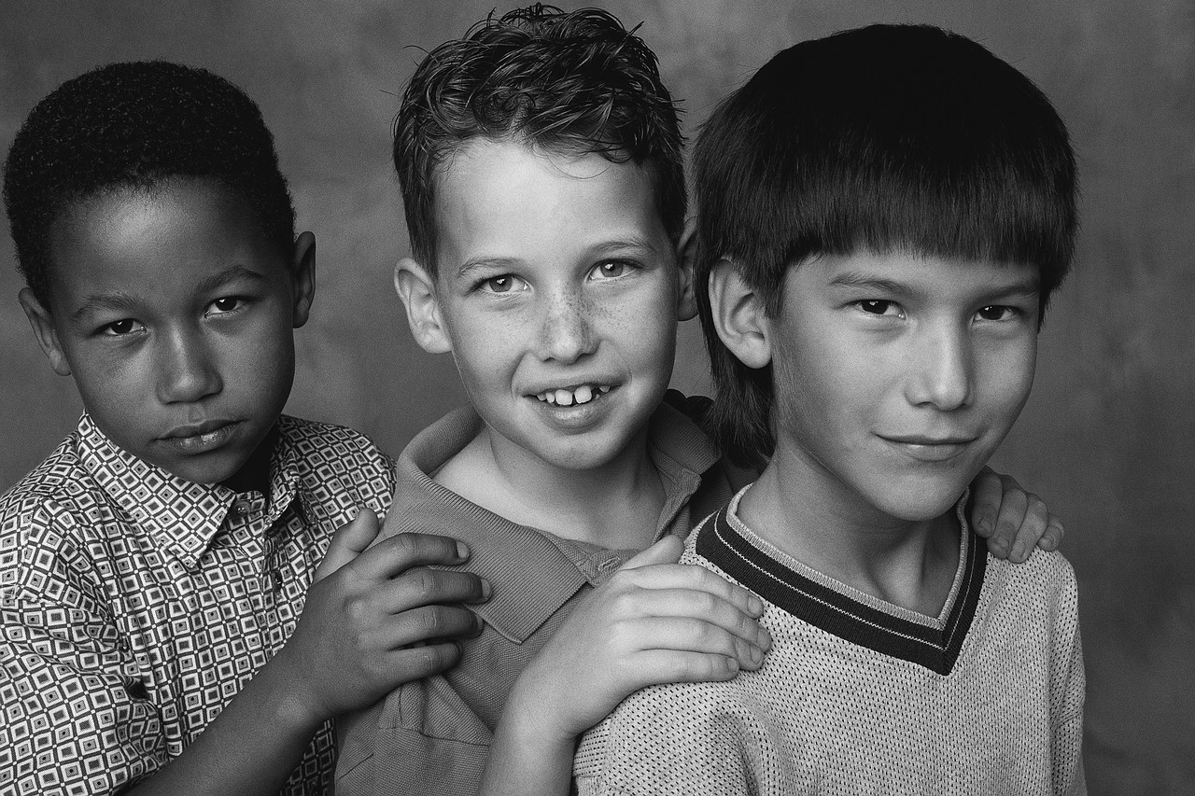
Adoption in Today’s Society
Just another way to form a Family
Today there are over half a million children in foster care.
Please think adoption as an option.

Slide 22

Gay & Lesbian Adoptions
Information from: http//www.adoption.com

Slide 23
Discrimation in Adoption
In the 1990’s, 10 million children were being raised by gays and lesbians,
  Today the numbers are higher.
People who oppose gay parenting often believe homosexuals are deviant.

Slide 24
Discrimation-cont.
Overwhelming research indicates that well over ninety percent of all incidents of sexual abuse reported in America, against boys and girls, are committed by straight men.
People hurt by all these prejudicial restrictions ultimately aren’t the adults at whom they are aimed, but the children who will continue to wait in foster care for homes with the “right” sorts of parents.

Slide 25
Worries
  Child will turn Gay or Lesbian.
  The child will be made fun of and will be ridiculed.

Slide 26
Legal Statistics
What states legalize it?
  All states excluding Florida and New Hampshire.
Many people lie about being gay or lesbian so they may adopt
  People say that the other man or woman is their roommate or friend.
  At times, the partner applies for second parent, later on, after the placement has been made.

Slide 27
Questions a Social
Worker Must Ask
Social Workers ask four questions, if a gay or lesbian person wanting to adopt, answers these questions right, they are eligible to adopt a child, if the state law coincides.
  Is this person or couple caring, nurturing, and sensitive to others?
  Do they have the qualities needed to parent a child?
  What are their individual strengths and weaknesses?
  Do they have the capacity to nurture a child not born to them?

Slide 28
Open & Closed Adoption
Information from :
Http://www.closedadoptions.com

Slide 29

Open Adoption
What is it?
  Open Adoption is when the birth mother and/or father may stay in contact with the child. They build up an ongoing relationship with the adoptive parents.
Will it be the norm for now on?

Slide 30
Pro’s of Open Adoption
The child will not have the mystery of not knowing their birth parents.
Birth parents will be able to control who their child is adopted by.
Birth parents may maintain a relationship with the child.
The birthmother can answer any questions the child may have regarding their adoption.

Slide 31
Con’s of Open Adoption
The child may be confused as to whom their “real” parents are.
The adoptive parents may feel that the birth parents are intrusive.
There may be more of a fear that the birth parents may want to take back the child and change their mind.

Slide 32
Semi Open Adoption
What is it?
  Sharing first names only between birth parents and adoptive parents.
  Sharing pictures or letters only after the placement has been made.

Slide 33
Pro’s of Semi Open Adoption
The child may still see who their birth parents are.
The birth parents may answer many un-answered questions that the child may have through letters.
The birth parents may choose the adoptive parents.
The child may keep some a small relationship with their birthparents.

Slide 34
Con’s of Semi Open Adoption
The child or birthparent may want more of a relationship with the child that was agreed upon.
Adoptive parents have more of a fear that the birth parents may want their child back.

Slide 35

Closed Adoption
What is it?
  Completely Confidential
  No contact among birthparents and adoptive parents, as well as the child.
  Very common in the past but is becoming less of a norm in today’s world.

Slide 36
Pro’s of Closed Adoption
The child will not be confused as to whom their parents are.
There is less fear of the birthparents changing their mind.

Slide 37
Con’s of Closed Adoption
The child may have many unanswered questions as to why they were adopted, who their parents are, and what they are like.
The birth parents will not know anything about their child they chose to give up for adoption.
They may not choose who the adoptive parents are.

Slide 38
Related & Unrelated Adoptions

Slide 39
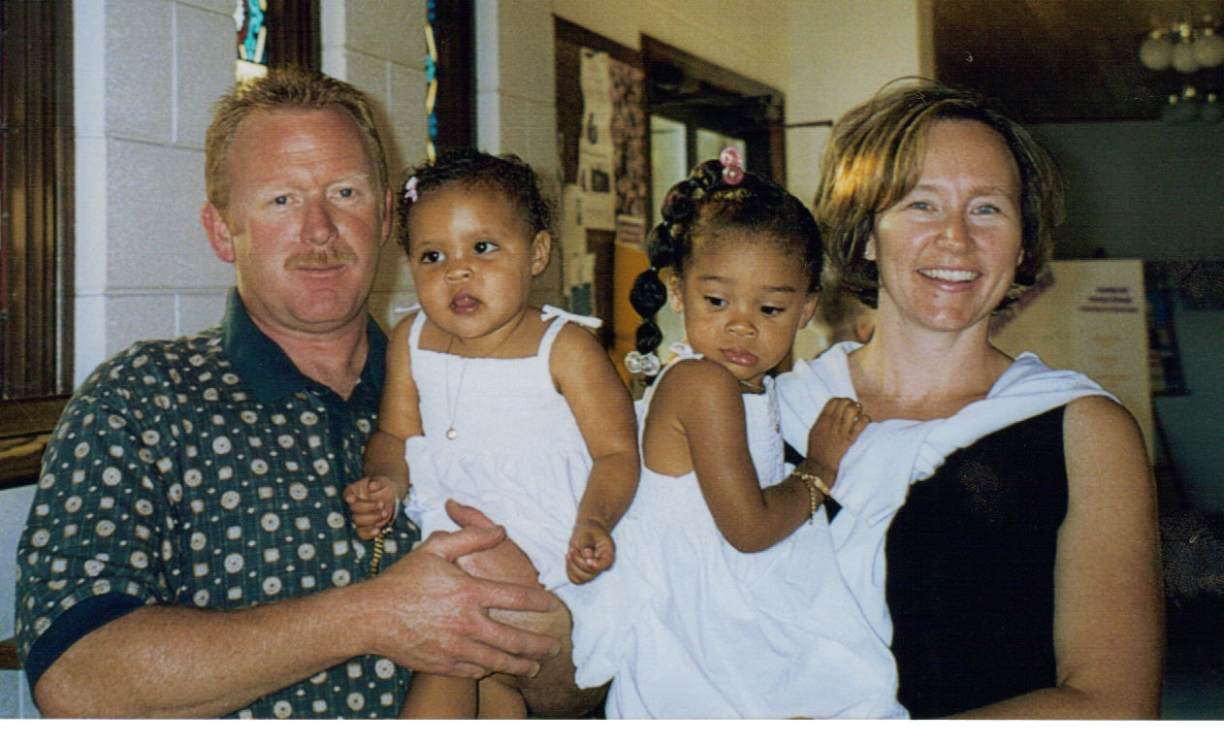
Unrelated
When a person unrelated to the child, adopts the child

Slide 40
Out of Family Adoption Legal Procedures
Social history (send copies to adoption worker)
Adoption placement agreement (subsidy, funded through the state)
Adoption petition
Court sets a date for finalization

Slide 41
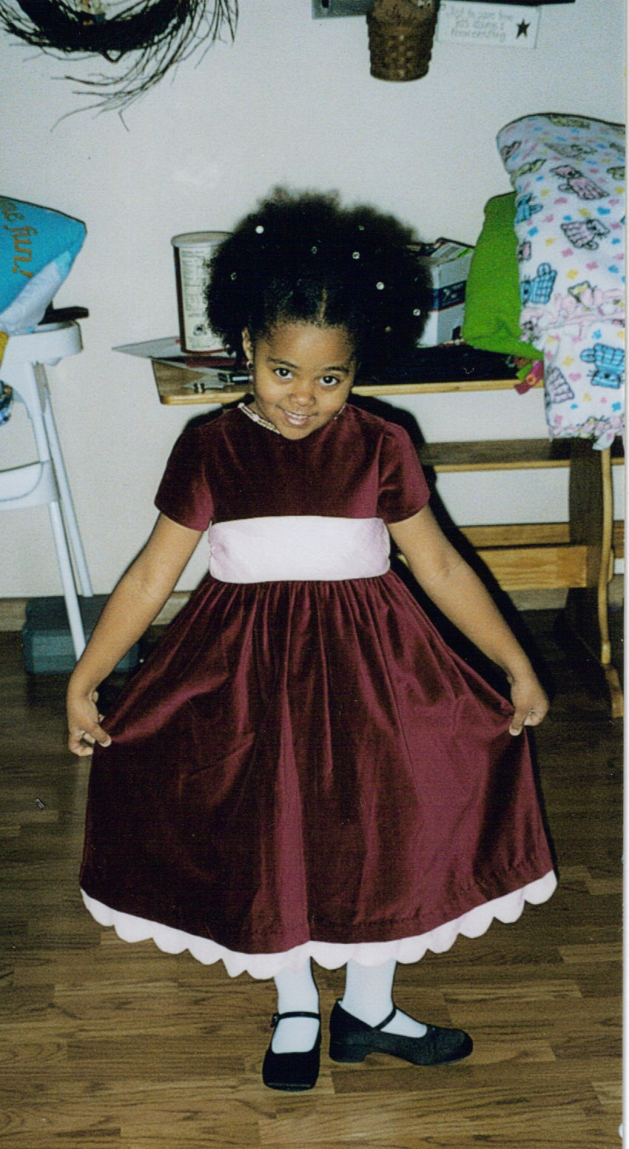
Related
Typically between a child and stepmother or stepfather but, can also be when a family member adopts another family member

Slide 42

International Adoption
Information from http://swa.net/
&
http://adoption-service.com/

Slide 43
Small World Organization
  “A non-profit public benefit Christian charity that is dedicated to preserve and enhance the lives of children at home and around the world.”
  Countries served
    China1995
    Russia1994
    Mongolia 2003
    Guatemala

Slide 44
Small World Organization Cont.
  Small Statistics
    Started in Nashville, TN in 1985
    Provide English speaking representatives to help the process easier.
    Children are in an orphanage during the adoption process

Slide 45
Orson Mazes Program
“Provides loving, permanent and stable homes to orphaned children.”
Domestic and International adoptions
Countries Served:
  Kazakhstan, Azerbaijan, Guatemala, Nepal, and Ukraine.
Provides counseling and assistance for the adoptee’s placed through Adoption International Program, Inc.

Slide 46

Adoption Statistics
Information from:
  http://adoptionblog.typepad.com/adoption/2005/12/adoption_statis.html

Slide 47
Adoption Statistics
1.6 million children under 18 are adopted
Alaska has the highest rate of adoption at 3.9%
90 boys adopted for every 100 adopted girls
16% of all adopted children are African American
17% of adopted children are adopted into a household of a different race
13% of adopted children are foreign

Slide 48
Adoption Statistics Cont.
48,000 children are adopted from Korea
1.7 million Households have an adopted child
- 82% have one adopted child
- 15 % have two adopted children
- 3% have three or more adopted children
43 is the average age that people adopt children, which is about 5 years older than when people have children biologically
$56,000 is the median income for households with adopted children
33% of people who adopt have at least their bachelor’s degree
78% of adopted children live in a house that is owned

Slide 49

Adoption: It’s Impact on Today’s Society
Adoption impacts our:
  View of ourselves
  Changing families
  Acceptance of non-traditional families
  Growing connection to a global world
Notes:
Adoption
Impacts Our Changing Families

